Slide 1
EXPENSES TRACKER SYSTEM
A Comprehensive Solution for Financial Management
Faculty: Dr. Vinoth D
B. Hemanth Chowdary
Date: 22-03-2024
Notes:
In today's world, managing finances effectively is crucial. An expense tracker system can be a valuable tool to gain control of your spending habits and make informed financial decisions. This presentation will explore how Java, a powerful programming language, can be used to build a robust and user-friendly expense tracker system.

Slide 2
ABSTRACT
Importance: Efficient expense management crucial for individuals and businesses.
Solution: Expense Tracker System developed in Java.
Objectives: User-friendly interface, robust features, budget management, reporting, data security.
Keywords: Expense tracking, budget management, Java development.
Notes:
Efficient expense management is crucial for financial stability and informed decision-making. The Expense Tracker System aims to address this need by providing a user-friendly and feature-rich application. This project focuses on user experience, robustness, and data security. The key functionalities include expense tracking, budget management, reporting, and data persistence. All these features are developed using Java programming language.

Slide 3
INTRODUCTION
Challenges in Manual Expense Management:
Time-consuming data entry.
Difficulty in categorizing expenses.
Risk of losing paper receipts.
Inability to generate reports easily.
Importance of Expense Tracking:
Gain control over finances.
Identify spending patterns.
Make informed budgeting decisions.
Achieve financial goals.
Notes:
The Expense Tracker System offers a digital solution for individuals and businesses to manage their finances effectively. Tracking expenses is essential for understanding your financial health. It helps identify areas where you can potentially save money and make informed decisions about budgeting and spending. Manual methods of expense tracking, such as spreadsheets or handwritten records, can be cumbersome and prone to errors. The Expense Tracker System eliminates these challenges by providing a digital platform for efficient expense management.

Slide 4
OBJECTIVES
User-Friendly Application: Easy to navigate interface for users of all technical backgrounds.
Robust Features: Comprehensive functionalities to meet various expense tracking needs.
Budget Management: Tools to set budgets, track progress, and receive alerts.
Reporting Capabilities: Generate insightful reports to analyze spending patterns.
Data Persistence and Security: Secure storage of financial data with access control.

Slide 5
METHODOLOGY
PHASES:
Requirement Gathering: Understand user needs and system functionalities.
Design: Create system architecture, user interface design, and data models.
Implementation: Develop the application code based on the design.
Testing: Conduct thorough testing to ensure functionality and identify bugs.
Deployment: Release the application for user access.
TOOLS AND TECHNOLOGIES:
Programming Language: Java
Programming Environment: Visual Studio Code, JAVA IDE
Notes:
- Expense Tracker System development followed an iterative approach, breaking down the project into smaller phases.
- Five key phases: requirement gathering, design, implementation, testing, and deployment.
- Requirement gathering defined user needs and system functionalities.
- Design focused on system architecture, user interface, and data models.
- Implementation developed application code based on design.
- Rigorous testing ensured functionality and identified bugs.
- Finally, deployment made the system accessible to users.

Slide 6
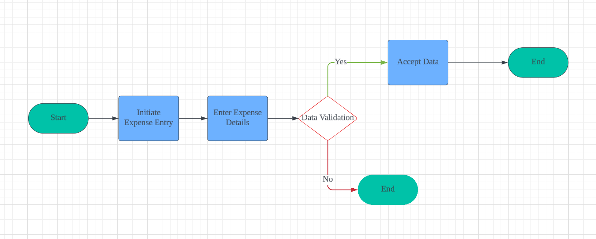
FLOW CHART

Slide 7
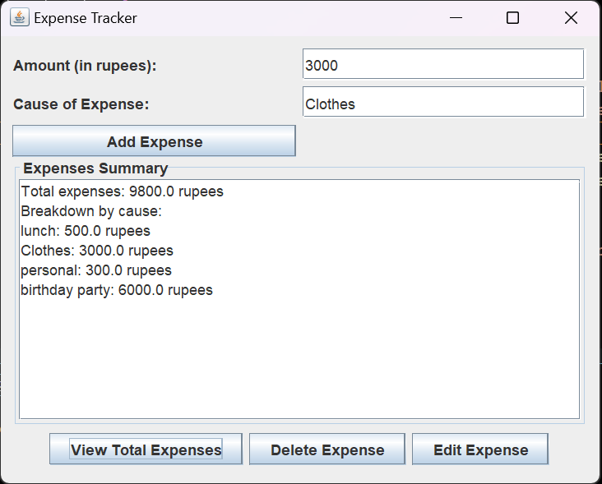
OUTPUT

Slide 8
FUTURE ENHANCEMENTS
Integration with Online Banking: This feature would enable secure import of transaction data directly from a user's bank account.
Machine Learning for Expense Categorization: Machine learning algorithms can be implemented to automate expense categorization. The system would learn from past entries and suggest categories for new expenses, improving accuracy and efficiency.
Multi-User Support: Expanding the system to accommodate multiple users would be beneficial for families or businesses.
Mobile Application Version: Developing a mobile application would provide users with on-the-go access to their expense tracker.
Notes:
These future enhancements hold immense potential to transform the Expense Tracker System into an even more powerful financial management tool. Integration with online banking and machine learning would significantly reduce manual effort and improve data accuracy. Multi-user support would cater to group budgeting needs, while a mobile application would offer unparalleled convenience. Advanced reporting would empower users to gain deeper financial insights and make data-driven decisions. By incorporating these advancements, the Expense Tracker System can become an indispensable companion on your journey towards financial well-being.

Slide 9
CONCLUSION
Throughout this presentation, we've discussed the importance of effective expense management and introduced the Expense Tracker System as a solution to this challenge. We've outlined its objectives, development phases, future enhancements, and potential impact on financial management.

Slide 10
Thank You
Notes:
Thank you for your attention and engagement during this presentation. I invite any questions or discussions you may have regarding the Expense Tracker System or any aspect of financial management. Your input is invaluable as we strive to enhance and optimize our system to meet your needs effectively.

